Slide 1

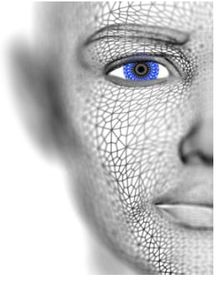
University of Missouri-Columbia - College of Engineering – Electrical Engineering and Computer Science Dept.
Localized Deep Learning Structure for The Large-Scale Biometric Data Recognition
PhD Candidate EECS
Adil Al-Azzawi
Adil Al-Azzawi

Slide 2
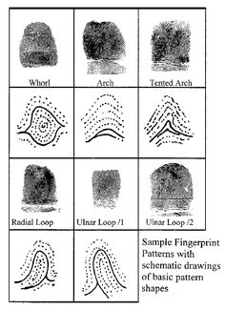

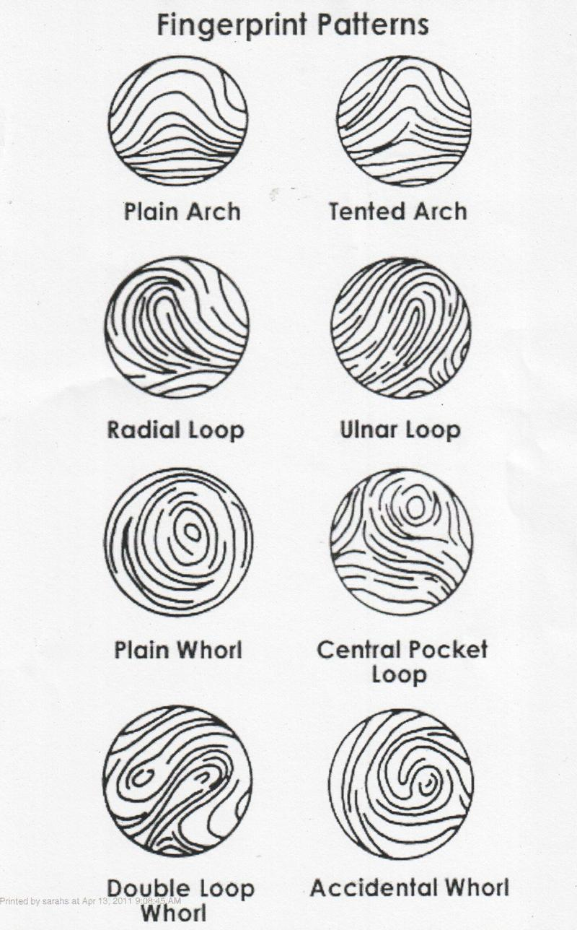
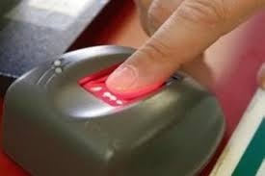
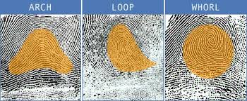
Motivation
Fingerprint pattern detection and Identification
Adil Al-Azzawi

Slide 3
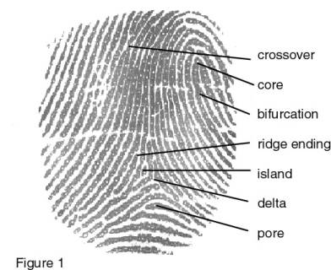
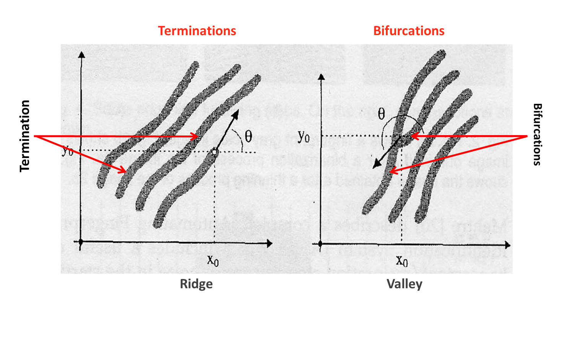
Biometric Fingerprint (Main Approach)
Most of fingerprint automatic systems are based on minutiae matching.
Minutiae points in the fingerprint pattern refer to ridge termination and bifurcations.
Ridge termination indicates the point where the ridge ends.
Ridge bifurcation refers to the point where single ridge splits into two ridges
Adil Al-Azzawi

Slide 4

Biometric Fingerprint (Main Approach)
Localized Features Approach
Image Acquisition
Image Processing
Image Binarization
Feature Extraction
Block Direction
Image Thinning
Post Processing
Minutiae Marking
ROI
Remove False Minutiae
Template Registration
Stored Template
Template Matching
4
Adil Al-Azzawi

Slide 5
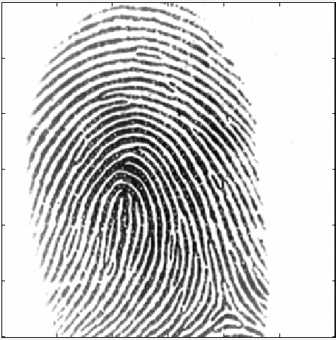
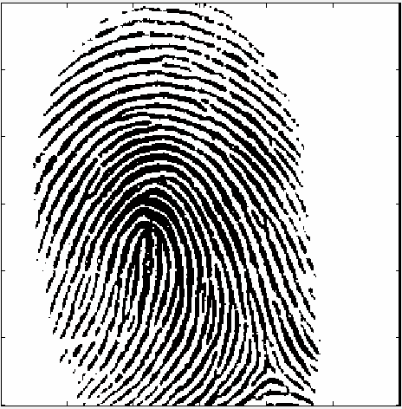
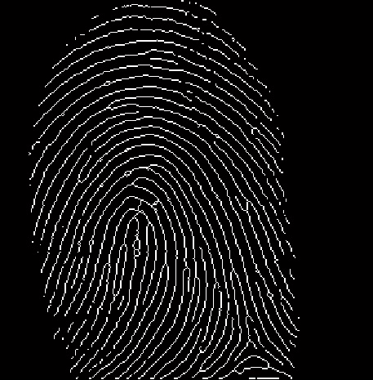
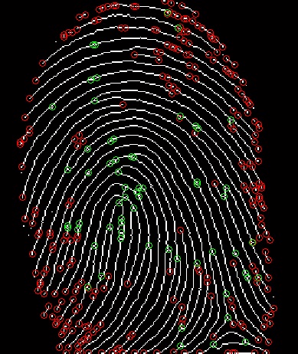
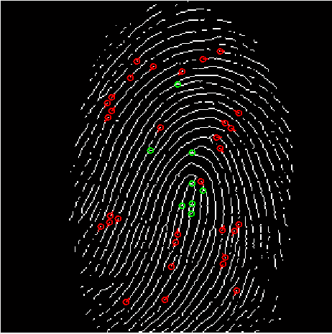
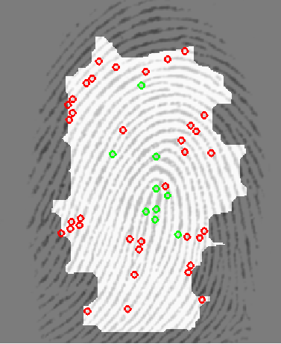
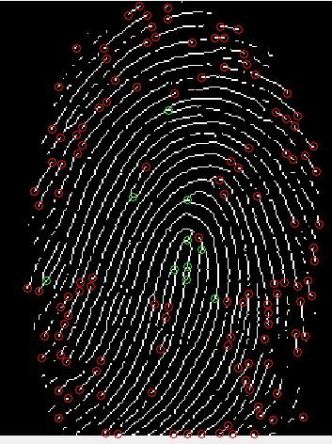
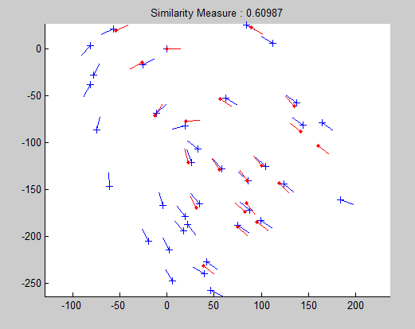
Biometric Fingerprint (Main Approach)
Original Finger Image
Binarization
Thinning
Minutia Features Ext.
Matching
Orientation
ROI
False Minutia
Adil Al-Azzawi

Slide 6
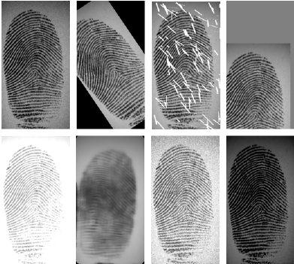
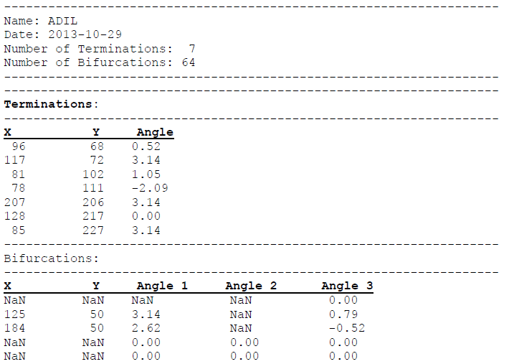
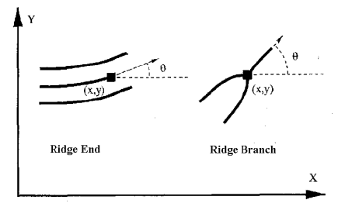
Main Challenges
Any Rotation , Noisy, Blurring , Poor quality or Incomplete image will effect on the fingerprint recognition?
Adil Al-Azzawi

Slide 7
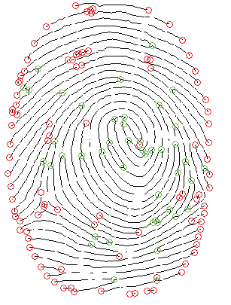
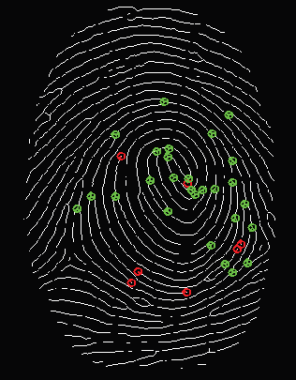
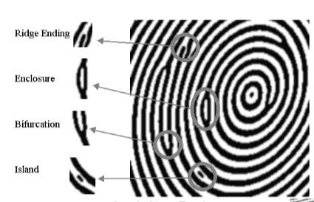
Main Challenges
Matching
X
X
X
Adil Al-Azzawi

Slide 8
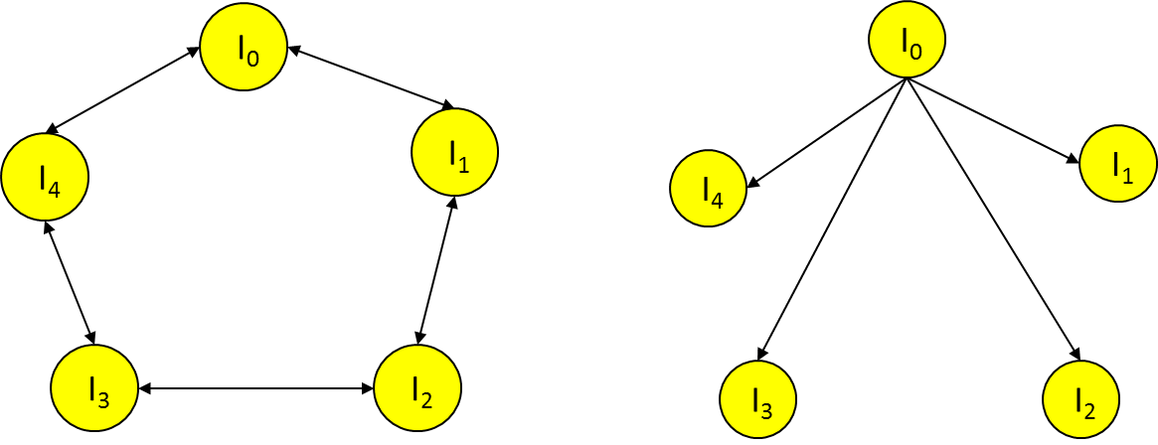
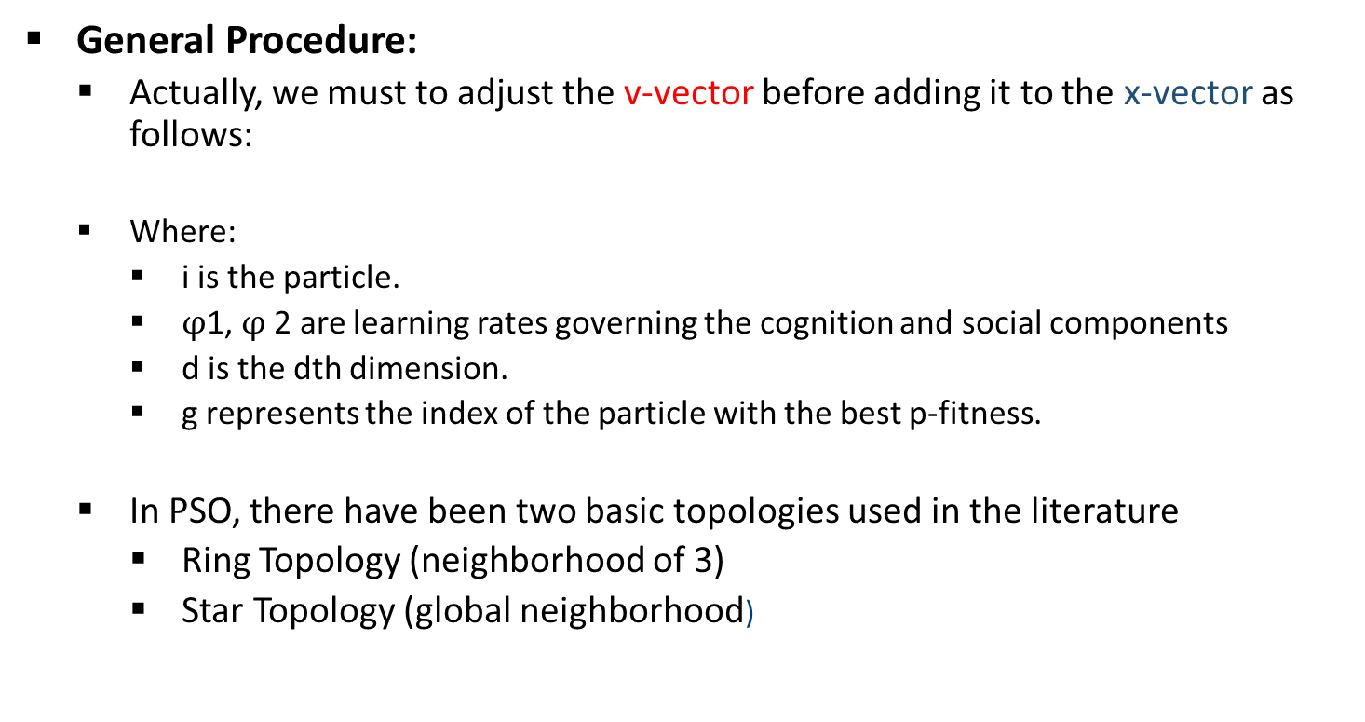
Proposed Solution
PSO Algorithm:
General Procedure:
Actually, we must to adjust the v-vector before adding it to the x-vector as follows:
Where:
i is the particle.
$φ$1, $φ$2 are learning rates governing the cognition and social components
d is the dth dimension.
g represents the index of the particle with the best p-fitness.
In PSO, there have been two basic topologies used in the literature
Ring Topology (neighborhood of 3)
Star Topology (global neighborhood)
v_{id} = v_{id} + ϕ1*rnd()*(p_{id}-x_{id}) + ϕ2*rnd()*(p_{gd}-x_{id});
x_{id} = x_{id} + v_{id}
Adil Al-Azzawi, Tony X. Han, “A Robust Spatially Invariant Model for Latent ingerprint Authentication Approach”, IEEE, DeSE, Developments in eSystems Engineering 2017
Adil Al-Azzawi

Slide 9
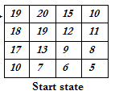
PSO (Practical Swarm Optimization) Model
General Procedure:
Step(1): Let generate a random swarm of partials in 2 dimension (4×4):
Step(2): Lest Xbest is the first location X(1,1)
Evaluation the fitness function f(Xi(t)):
f(x₁) = ((19-12.4)²)/16=2.7, f(x₂) = ((20-12.4)²)/16=3.61 f(_{x3}) = ((15-12.4)²)/16=0.423
f(x₄) = ((10-12.4)²)/16=0.36 f(x₅) = ((18-12.4)²)/16=1.96 f(x₆) = ((19-12.4)²)/16=2.7
f(x₇) = ((12-12.4)²)/16=0.01 f(x₈)= ((11-12.4)²)/16=0.123 f(4₉) = ((17-12.4)²)/16=1.32
f(x₁₀) = ((13-12.4)²)/16=0.02 f(x₁₁)= ((9-12.4)²)/16=0.72 f(x₁₂)= ((8-12.4)²)/16=1.21
f(x₁₃)= ((10-12.4)²)/16=0.36 f(x₁₄)= ((7-12.4)²)/16=1.8 f(x₁₅)= ((6-12.4)²)/16=2.56
f(x₁₆)= ((5-12.4)²)/16=3.4
Adil Al-Azzawi, Tony X. Han, “A Robust Spatially Invariant Model for Latent ingerprint Authentication Approach”, IEEE, DeSE, Developments in eSystems Engineering 2017
Adil Al-Azzawi

Slide 10
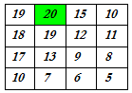
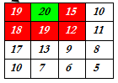
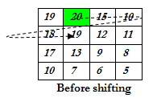
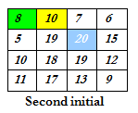
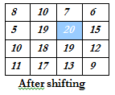
PSO (Practical Swarm Optimization) Model
Find the value of Mean(Xi(t))=(9+20+15+10+18+19+12 +11+17+13 +9+8+10+7+5) /16 = 12.4
Evaluate the fitness value for each particles by f(Xi(t))=xi-t(xi))
Determine the first optimal feature, Xbest=2
Change the velocity: V_{i}(t)=V_{i}(t-1)+P₁(X_{Pbesti}-X_{i}(t))+P₂(X_{lbest1}-X _{lbest})=19.5
Find the new state Xi(t)=Xi(t-1)+Vi(t) =1+19.5=20.5
Modify the position by 20.5 mod 16=5.5≈5
A
Adil Al-Azzawi, Tony X. Han, “A Robust Spatially Invariant Model for Latent ingerprint Authentication Approach”, IEEE, DeSE, Developments in eSystems Engineering 2017
Adil Al-Azzawi

Slide 11
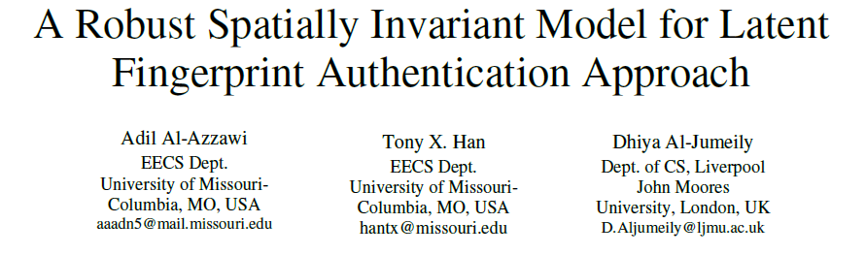


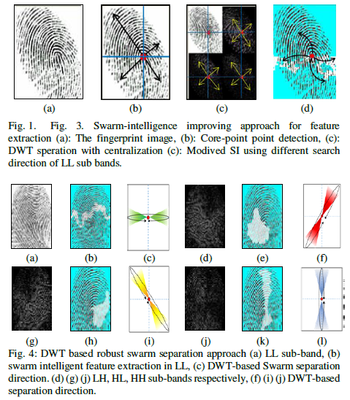
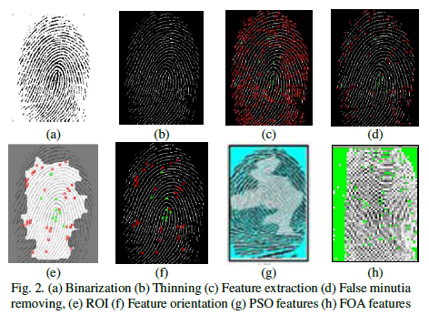
Previous Model
Adil Al-Azzawi, Tony X. Han, “A Robust Spatially Invariant Model for Latent ingerprint Authentication Approach”, IEEE, DeSE, Developments in eSystems Engineering 2017
Adil Al-Azzawi

Slide 12
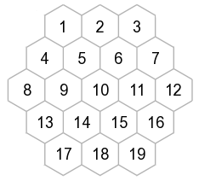
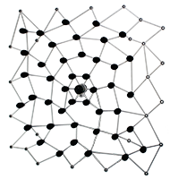
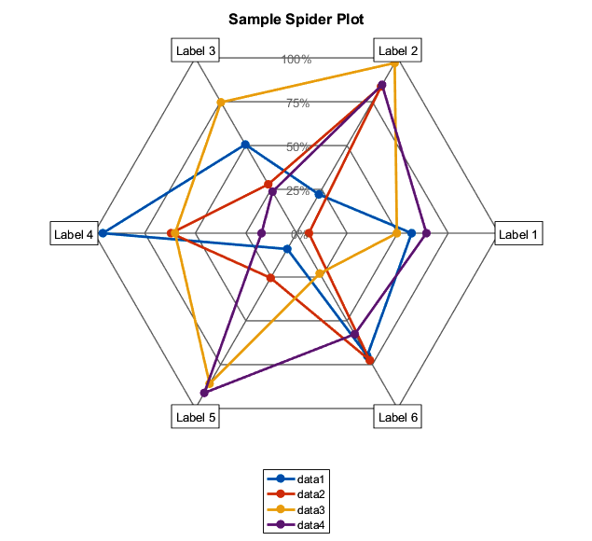
Current Work
Approach : Spider-Web based Model (Heuristic Random Space Searching Approach and Data structure) for Biometric Fingerprint Identification
Distribution
Structure
Searching Algorithm
In probability and statistics, a circular distribution or polar distribution is a probability distribution of a random variable whose values are angles, usually taken to be in the range of ) 0, 2π ) .
Adil Al-Azzawi

